Slide 1
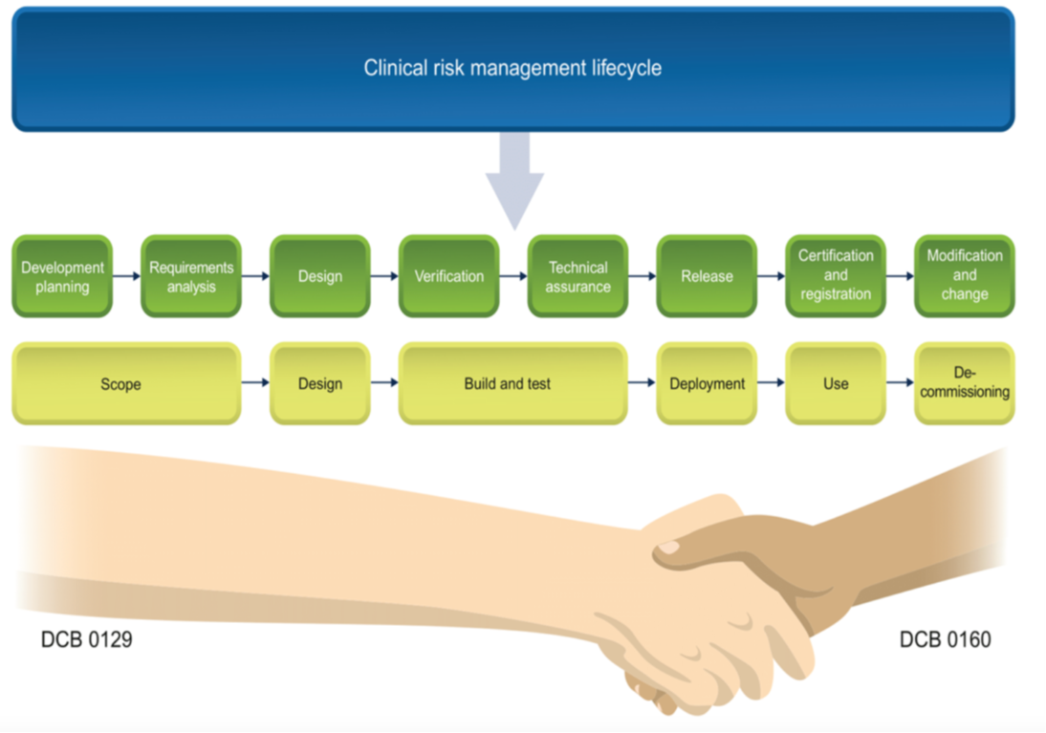
Purpose & Definitions
Purpose
The aim of these slides is to detail the steps to go through & meet the requirements set by DCB0160. Once the DCB0160 is complete, this will ensure that digital health products are safely implemented, used & maintained.
All key stakeholders and users should be aware of the basics of clinical safety and how by addressing key risks within the project roll-out can result in safer systems. The clinical risk management lifecycle shown here aligns to both medical devices and clinical safety terms and definitions.
Definitions
Deployment is the processes involved in getting new digital health product running in its environment. Includes the terms:
Installation
Implementation
Running
Use is often termed as the launch phase in medical device context. The new health IT software or medical device is released for public sale and actually used.
De-commissioning is sometimes called disposal, but we are not focussing on physical devices here. Removal of the software from the use phase.

Slide 2
Background
What is DCB 0160¹?
This standard provides a set of requirements suitably structured to promote and ensure the effective application of clinical risk management by those health organisations that are responsible for the deployment, use, maintenance or decommissioning of Health IT Systems within the health and care environment.
Organisations who implement health IT systems undertake a formal clinical risk assessment and evidence the measures which have been put in place to mitigate risk relating to the implementation and use of the health IT system.
To comply with the standard, an organisation needs to undertake a formal risk assessment on the product and produce three documents summarising the outcome; the Clinical Risk Management Plan, Hazard Log and Clinical Safety Case Report. The risk assessment needs to be carried out before a system goes live.
What is DCB 0129²?
The DCB0129 is the clinical risk management standard which manufacturers of health IT systems and apps need to comply with. This information standard is published under section 250 of the Health and Social Care Act 2012.
This standard provides a set of requirements suitably structured to promote and ensure the effective application of clinical risk management by those organisations that are responsible for the development and maintenance of Health IT Systems for use within the health and care environment.
To comply with the standard, an organisation needs to undertake a formal clinical risk assessment on the product and produce three documents summarising the outcome; the Clinical Risk Management Plan, Hazard Log and Clinical Safety Case Report.
The DCB 0129 standard is supplementary to the requirements of the NHS Information Governance Toolkit and the Medical Device Directive/Regulation.
SOURCE:
1. DCB 0160: Clinical Risk Management: its Application in the Deployment and Use of Health IT Systems
2. DCB0129: Clinical Risk Management: its Application in the Manufacture of Health IT Systems

Slide 3
DCB0160 - Priority activities
What are the minimum clinical risk management activities to implement our digital health product?
1
Review Supplier
3
Clinical Risk Documentation
Project Initiation
Appoint a Digital Clinical Safety Officer (CSO) - suitably trained and qualified.
Assess compliance obligations for DCB0160, obtain supplier DCB0129 compliance & CSO evidence; add reference in contract & Project Initiation Document (PID).
Assign project staff – suitable for ongoing clinical safety activities, appropriate to scale, complexity and level of risk of the release.
Go – No Go
Checkpoint
5
Receive DCB0129 docs
Review with supplier
Request amendments
Plan for additional clinical risk activities
Assign ownership of hazards
Update Hazard Log
Create Clinical Safety Case Report
Create Hazard Log
Identify stakeholders & invite
Run workshop
Review documents
Get approval
6
Post-release activities
4
Clinical Risk Actions
2
Clinical Risk Workshop

Slide 4
DCB 0160 – how this connects together
Clinical Safety activities relating to the health organisation decisions & project team:
Project Management – provides control over the health IT deployment and execution of clinical safety activities throughout
Senior leadership – provide overall governance and control
Testing – gives us assurance evidence that the digital health product system works as intended
Communications & Training – help to avoid human factors issues often seen with the inadequate engagement of users
Integration & Infrastructure teams – provide assurances and evidence that the health IT system can be supported within the health organisation from a technical point of view
Data Quality – provides evidence that benefits and clinical outcomes are met

Slide 5
Typical Health Organisation project team
Health Organisation Work-stream, Person or Team | Role(s) | Responsibilities | Health Organisation Area | Deliverables
Project Direction | Overall direction of the project | Manage and oversee project finances Provide assurances and updates to leadership team | Project Governance Project Reporting | Establishment of Project Board Establishment of the Project Team Highlight Reports Finance Reports
Chief Clinical Information Officer (CCIO) | Clinical link between Health Informatics and Clinical specialities or departments | Provide clinical steer and project leadership Seek assurances that patient safety is not compromised | Project Governance Leadership Change Management | Engage with the Clinical teams regarding the deployment of the health IT system
Finance Lead | Oversee financial spend | Provide support and assistance to the Project Director and Project Manager to ensure that budget is controlled | Project Reporting and Finance | Monthly finance report
Business As Usual (BAU) | Roles accounts and support Change request process | Oversee the creation and management of roles and accounts Cascade messages and training to the wider Health Organisation Teams; Form part of the key decision-making team in defining new processes and procedures – Standing Operating Procedures (SOPs) | BAU Project Delivery | Training material for BAU support Standard Operating Procedures for BAU Support
Notes:
SCRIPT
The World Health Organisation article advised as pre-reading, tells us of three or four components to the delivery of digital health interventions. In order to explain the clinical safety context of go or no-go decisions we focus on the third. The health organisation often have a lengthy programme of activities aligned to any safe deployment of health software. These start with a selection or tendering process to ensure the right choice of health IT system is made using fair and open competition aligned to known benefits and clinical outcomes.
After selection we work with the manufacturer to ensure they meet the required requirements and more importantly provide an accurate clinical safety case.
Other activities that provide additional control or mitigation to clinical safety hazards are listed here, together with the typical documentation a health organisation uses to make a go or no-go decision. The table shown provides an example of just how many different stakeholders or roles within a health organisation are involved in some of the more complex and higher risk deployments.

Slide 6
Typical Health Organisation project team
Health Organisation Work-stream, Person or Team | Role(s) | Responsibilities | Health Organisation Area | Deliverables
Testing | Oversee the User Acceptance and Technical Acceptance Testing including providing evidence of outcomes | Coordinate the testing and validation of the solution for all testing activity including providing evidence of outcomes; Provide clear guidance and support to the Project Director and Manager on best practice for testing; Log all test issues. | Project Governance Project Delivery | Test Strategy Test Plan Test Scripts Testing Test Outcome Report(s) Product Assurance
Project Management | Day-to-Day Project Management | Monitor project against plan, scope and deliverables Management and maintenance of Project Risks and Issues Management of each stage and escalation, if required Ensuring the undertaking of clinical safety requirements in line with the Clinical Risk Management of Health IT Systems Policy and DCB160 standards | Project Governance Project Reporting Project Delivery | PID and Detailed Implementation Plan Project Closure Report, Lessons Learnt Report Project Risk Log, Highlight Reports Gateway/ End Stage Reports A fully configured and stable solution Deployment into Early Adopter Deployment and use of health IT system across the Trust Establishment of clinical processes using the new health IT system Data Quality Reporting

Slide 7
Typical Health Organisation project team
Health Organisation Work-stream, Person or Team | Role(s) | Responsibilities | Health Organisation Area | Deliverables
Communications, Engagement & Change | The management and transition of change within the Trust encompassing stakeholder engagement | Direct the overall Change Management activities from the existing ways of working to the new, future state Ensure that key messages are in line with various other activities and functions, against the deployment plan | Project Governance Project Delivery | Change Management Strategy and Plan Stakeholder Engagement Strategy including a complete stakeholder analysis and influence/impact grid Stakeholder Engagement Plan Stakeholder Engagement Audit Reports Engagement Materials Updated Trust Policies and SOPs Establishment of various Advisory Groups (Clinical, Operational and Non-Clinical) Process Mapping
Executive Sponsorship | Chief Information Officer Senior Responsible Owner Executive Nurse Medical Director | Provide strategic context to the project. Ensure clinical safety officer responsibilities are upheld. Provide project steer, guidance and leadership Remove barriers, as and when they arise | Project Governance | Gateway Sign off Cycle(s) Sign off

Slide 8
Typical Health Organisation project team
Health Organisation Work-stream, Person or Team | Role(s) | Responsibilities | Health Organisation Area | Deliverables
Training | The management and delivery of effective training | Delivery of training using various training approaches; The development of eLearning material The development of learning material; The development of a Training Strategy and Plan | Project Governance Project Delivery | Training Strategy Training Plan Training Materials including eLearning Delivery of training
Technical Integration & Infrastructure | Ensure that the solution is technically stable and that monitoring is place for the various feeds Ensure that the Trust has the appropriate hardware to function | Validation of the environments and infrastructure against the original requirements Establish monitoring and reporting | Project Delivery | Validation of Live, Training and Test Environments Interfaces & Integration Technical Architecture Document Standard Operating Procedure for the management of the environments

Slide 9
Typical Health Organisation project team
Health Organisation Work-stream, Person or Team | Role(s) | Responsibilities | Health Organisation Area | Deliverables
Data Quality | The management of the digital health record | Ensure that through the transition, the digital health record is maintained Draft and agree SOP’s for the Data Quality Team; Training of the Data Quality Team; Form part of the key decision making team in defining new processes and procedures | Project Delivery | Standard Operating Procedures for the Data Quality Team Training of the Data Quality Team
Manufacturer | Provide the health IT solution | Work with the Health Organisation | Project Delivery | Detailed Implementation Plan Test Strategy and Plan Technical Architecture Document Exceptions Reports A fully configured and stable solution

Slide 10
DCB 0160 – typical digital health hazard
Hazard Identification & Initial Assessment
Hazard | Effect | Harm | Possible Causes | Existing Controls
Incorrect Clinical Diagnosis | Incorrect patient data uploaded | Patient receives incorrect diagnosis | Staff member may inadvertently enter an incorrect patient number. Staff member may incorrectly identify a patient. Insufficient training of staff. Out of Date or incorrect Standard Operating Procedures. Digital health system not operating as intended or designed. | Staff to check Patient ID to ensure they record against correct patient. Current roles and responsibilities for clinical and non-clinical staff are well defined. There is a Duty of Care & correct identification of patient at the point of care. Current staff should have a familiarity and professional accountability on the use of health IT systems, including those that are new to the organisation.

Slide 11
DCB 0160 – typical hazard mitigation and control
Hazard Controls
Technical Assurance | Training | Business Process | Manufacturer
Technical Assurance should incorporate a test environment representative to the health IT system to be implemented. This allows new and existing users to check procedures work and deliver expected results prior to implementation. Technical Integration The following activities must occur prior to deployment: Validation of Live, Train and Dev Environments. Interfaces to other systems tested. Testing of the health IT system Test Strategy, Test Plan, Test Scripts, Test Outcome Report(s) | All staff should be trained on the system prior to implementation. Use of floor walkers who are experienced to provide "expert" on-the-spot guidance should be available. Training records and knowledge resources should be maintained, and be representative of the health IT system being used: • Training Strategy • Training Plan • Training Materials including eLearning • Delivery of training | All relevant Standard Operating Procedures must be approved and tested to ensure they represent the clinical workflow to be implemented and used. | Digital Health product manufacturer must provide a stable solution that is fit for purpose. Digital Health product is compliant with clinical safety standards and have the appropriate clinical safety documentation available. External Partners must provide input to the following deliverables for safe delivery: Implementation project plan Test strategy and plan Lessons learnt report Highlight reports Gateway reviews

Slide 12
Worksheet _____________ of __________________ | Date:
Section / Task
Description of section or task to be analysed (including inputs, outputs, descriptions of activities, resources (people, drugs, equipment) , controls and other comments | Team
Consequence seldom changes! Focus on likelihood.
No. | Hazard Effect | Hazard Name | Harm | Possible Causes | Existing Controls | Initial Risk Rating |  |  | Additional Controls |  |  |  | Residual Risk Rating
 |  |  |  |  |  | C | L | R | Design | Test | Training | Business Process Change | C | L | R
1
2
3
4
5
6
Implementation / Deployment
SoP, Workflow, Clinical / Patient Use
Mitigation
All controls must be simply summarised as to why they provide the control. References to evidence where more detailed explanation can be found must be provided.
Start with the hazard name and then think about the effect this may have, then move over to harm and think about the harm to the patient directly.

Slide 13
Results – extract of typical AI / ML hazard log
Hazard Identification & Initial Assessment
Effect | Hazard | Harm | Possible Causes
Software failure or data error | Digital Health Intervention failure | Delay in the diagnosis and on-going treatment of the patient | Undetected software failure or data error causes algorithm to incorrectly or inaccurately process input data. Resulting in unexpected system behaviour and processing delays.
Hardware or cloud services error | Digital Health Intervention failure | Delay in the diagnosis and on-going treatment of the patient | Health organisation infrastructure does not meet the minimum required specification for the non-functional / volumetric performance of the system.
File corruption - including displayed image | Digital Health Intervention failure | Patient receives incorrect diagnosis. | CT scores a CT scan and generates output; virus corrupts files; results are displayed incorrectly; physician chooses wrong treatment.
Software failure or data error | Digital Health Intervention failure | Patient receives incorrect diagnosis. | Undetected software failure or data error causes algorithm to incorrectly or inaccurately process input data. Output results are inaccurate providing false positives or false negatives and/or incorrect classification of fresh hypo density.
Inability to evidence overall end to end AI safety for the system. | Digital Health Intervention failure | Patient receives incorrect diagnosis | Coverage RSD does not detect inferences for border cases and outliers.. Underrepresent Minority populations not sufficiently represented in the synthetic dataset. Unwarranted The resultant dataset creates inferences unwarranted in the real data. Lack of consistency in the system behaviour. Concept Drift, Brittleness. Lack of integrity of system and vulnerability to security attack.

Slide 14
Summary and next steps
The effectiveness of Clinical Safety compliance is dependent on the following:
Manufacturer co-operation and compliance to DCB 0129 and any other relevant standards (e.g. Medical Device Regulations)
Project team awareness of clinical safety
Clinical engagement
Communication within the project
Results:
This guidance document
Sample hazards taken from the first AI implementation using this method within the health organisation
Next subsequent project must develop from the previous project (lessons learnt, good practise & shared hazards!)
Note: This guide should be accompanied with a sample Clinical Safety Case Report and Hazard Log.

